Slide 1
X-READ
Kyra Lee, Silver Harris, Victoria Puck-Karam

Slide 2
DISEASES CHOSEN
Name | Definition | # of .pngs | % of American population affected (per year)
Atelectasis | Partial or total collapse of the lung when alveoli deflate or are filled with alveolar fluid | 11,559 | >.06%
Effusion | Fluid buildup between tissues that line the lungs and the chest | 13,317 | >.06%
Infiltration | Diffusion or accumulation of foreign substances | 19,894 | 7%
Mass | A build up of cells leading to the formation of a mass | 5,782 | .001-.3%
Nodule | A small, palpable mass usually on the epidermis | 6,331 | .5%

Slide 3
TRAINING PROCESS
Each disorder took 10 hours to train
Used 10 layers of epochs to make the algorithm more accurate
Saved trained models into .h5 files
Able to run trained algorithm remotely, will identify in under a minute
Some disorders were harder to identify due to:
Lack of pictures to allocate to training and test
Monochrome nature of x-rays
Some disorders were more visibly obvious (mass)
Average val_accuracy: 65-70%
Average val_loss: 75-85%

Slide 4
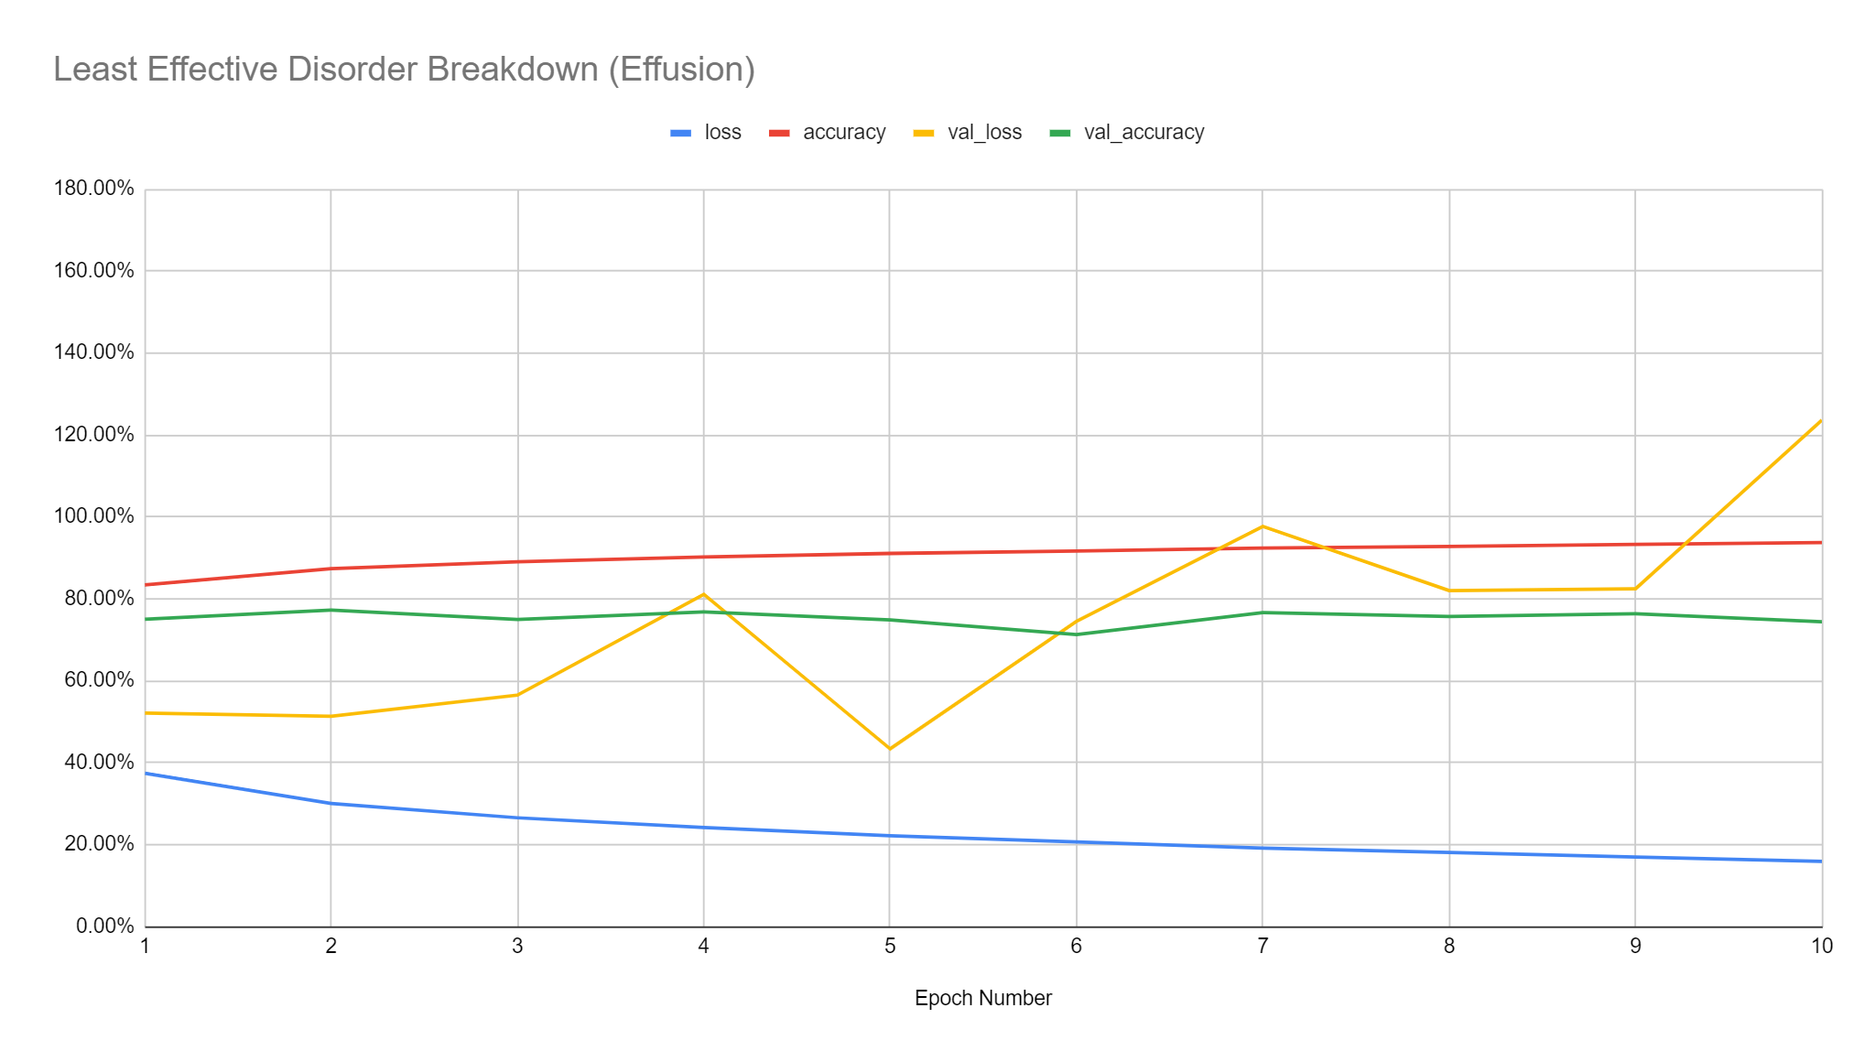
WORST ACCURACY: EFFUSION

Slide 5
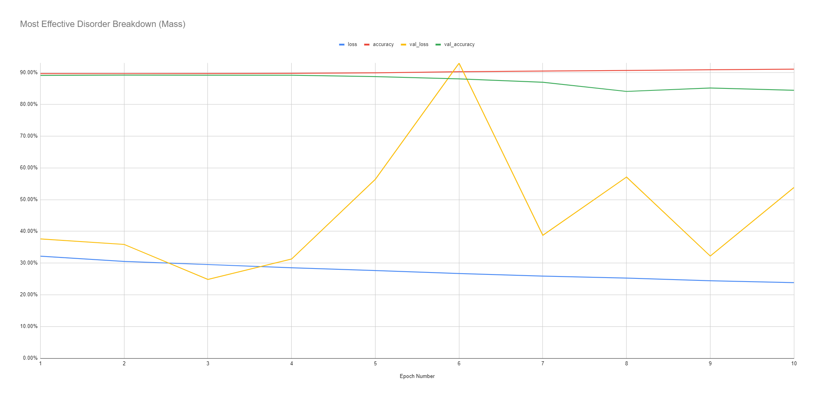
BEST ACCURACY: MASS

Slide 6
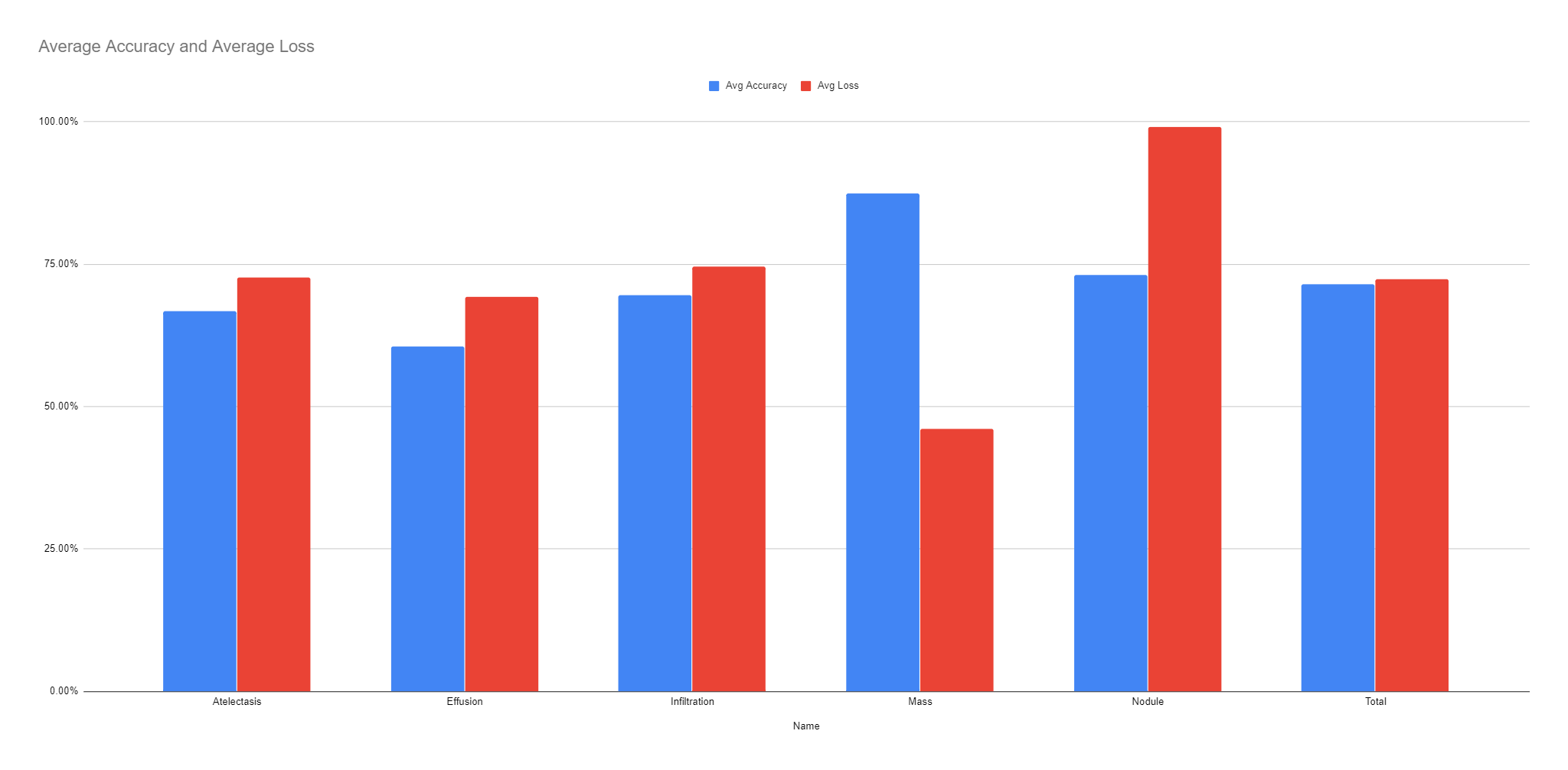
AVERAGE ACCURACIES AND LOSSES

Slide 7
FUTURE PLANS
Create user friendly interface
Create program that enhances contrast of X-ray RGB values to make the CNN more accurate
Possibly invert colors to do such
Use contrast limited adaptive histogram equalization
Train remaining 9 cardiothoracic abnormalities
Create program to recognize other x-rays
Broken bones
Fractures
Delete the 60,000 photos off the computer to increase memory

